Slide 1
+
=

Slide 2
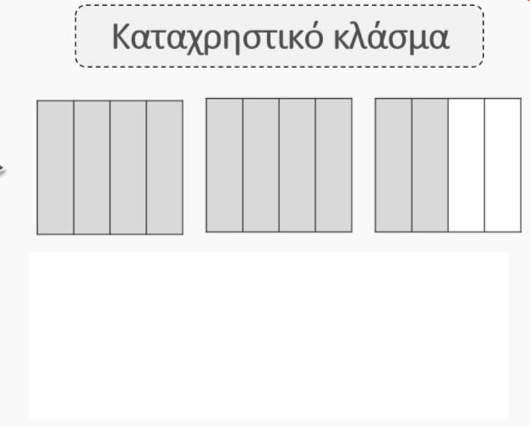
=
+
+
1 + 1 +
= 2

Slide 3
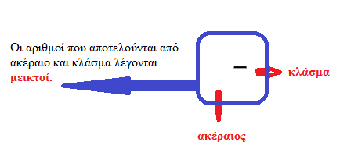
2

